Slide 1
EMILEY 1.0
Voice Assistant using Python
Done by
Harini.B

Slide 2
Table of content:
Introduction
Existing system VS Proposed System
Flow Diagram
Modules
Working
Implementation
Screen shots
Requirements
Conclusion

Slide 3
IntRoduction
The main motive of this project is developed for physically challenged person. Voice technology can help to improve productivity as voice assistant can remember important
The voice assistance takes the voice input through our microphone and it converts our dates or deadlines, schedule,etc.. Voice into computer understandable language This Assistant connects with the world wide web to provide result that the user has questioned.

Slide 4
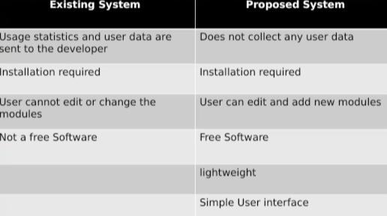
Existing system VS Proposed System

Slide 5
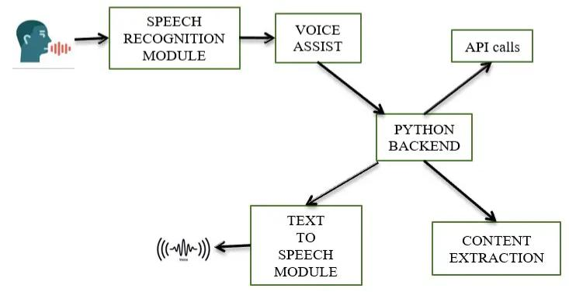
Flow diagram

Slide 6
Modules
Sub process:- This module is used to get system sub process details used in various commands i.e. Shutdown, Sleep, etc. This module comes built-in with Python. Wolfram Alpha:- It is used to compute expert-level answers using Wolfram’s algorithms, knowledgebase and AI technology. To install this module type the below command in the terminal.
Pip install wolframalpha Pyttsx3:- This module is used for the conversion of text to speech in a program it works offline. To install this module type the below command in the terminal. Pip install pyttsx3

Slide 7
Modules
Wikipedia:- we have used the Wikipedia module to get information from Wikipedia or to perform a Wikipedia search. To install this module type the below command in the terminal. Pip install Wikipedia Speech Recognition:- Since we’re building an Application of voice assistant, one of the most important things in this is that your assistant recognizes your voice (means what you want to say/ ask). To install this module type the below command in the terminal. Pip install Speech Recognition Web browser:- To perform Web Search. This module comes built-in with Python.

Slide 8
Modules
Date time:- Date and Time are used to showing Date and Time. This module comes built-in with Python. Twilio:- Twilio is used for making calls and messages. To install this module type the below command in the terminal. Pip install Twilio Requests:- Requests is used for making GET and POST requests. To install this module type the below command in the terminal. Pip install requests
Smtplib: - This module helps in sending emails.

Slide 9
Working
1. First, we import the modules. 2. Followed by this, we will be building the voice assistant and create function to speak using the voice engine 3. Then we create the function to wish, get the name of the user and command 4. Next, we will be writing functions to do various tasks like getting a weather report, sending mail, etc. 5. Finally, we write the while loop to run the assistant continuously. In which we take the command and check the command to do the respective task using if else statements. 6. Note that all the tasks we include are our choice. Depending on your comfort, you can add required commands and remove the ones that you don’t need. And make the voice assistant based on your suitability.

Slide 10
Implementation
Import subprocess import wolframalpha import pyttsx3 import random import speech_recognition as sr import wikipedia import webbrowser import os import winshell import pyjokes

Slide 11
Building the Voice Assistant and write function to speak
voiceEngine = pyttsx3.init(‘sapi5’) voices = voiceEngine.getProperty(‘voices’) voiceEngine.setProperty(‘voice’, voices[1].id) def speak(text): voiceEngine.say(text) voiceEngine.runAndWait()

Slide 12
Writing functions to wish, get username, and get command
def speak(audio): engine.say(audio) engine.runAndWait() def wishMe(): hour = int(datetime.datetime.now().hour) if hour>= 0 and hour<12: speak(“Good Morning Mam !”) elif hour>= 12 and hour<18: speak(“Good Afternoon Sir !”)
else:
speak(“Good Evening Mam !”)

Slide 13
Contds…
Def takeCommand():
r = sr.Recognizer() with sr.Microphone() as source: print(“Listening…”) r.pause_threshold = 1 audio = r.listen(source) try: print(“Recognizing…”) query = r.recognize_google(audio, language =‘en-in’) print(f”User said: {query}\n”) except Exception as e: print(“Unable to Recognize your voice.”) return “None”
return query

Slide 14
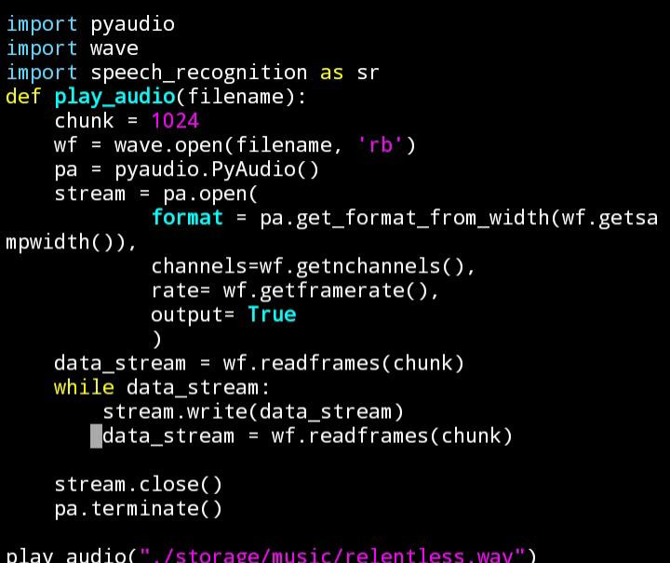
Screenshots

Slide 15
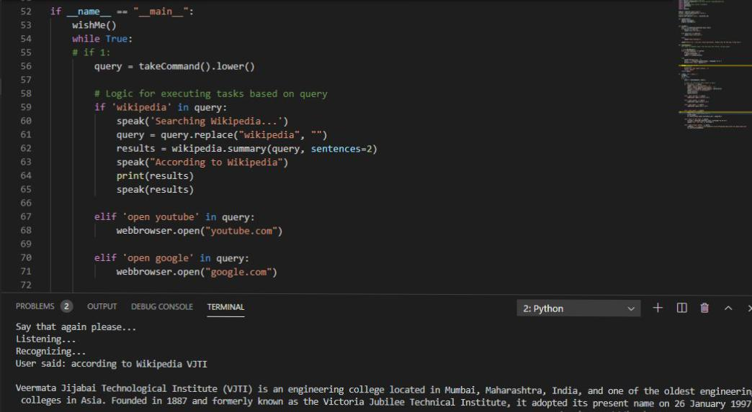
Screenshots-Output

Slide 16
Requirements
Software requirements Pycharm IDE/visual studio code Inno Setup Compiler Python 3.8.2 and its Sub modules Hardware requirements Intel core i3 4gb RAM 30 Gb Hard drive space

Slide 17
Reference
[1] R. Belvin, R. Burns, and C. Hein, "Development of the HRL route navigation dialogue system," in Proceedings of ACL-HLT, 2001
[2] V. Zue, S. Seneff, J. R. Glass, J. Polifroni, C. Pao, T.J.Hazen,and L.Hetherington, "JUPITER: A Telephone Based Conversational Interface for Weather Information," IEEE Transactions on Speech and Audio Processing, vol. 8, no. 1, pp. 85-96, 2000.
[3] M. Kolss, D. Bernreuther, M. Paulik, S. Stucker, S. Vogel, and A. Waibel, "Open Domain Speech Recognition & Translation: Lectures and Speeches," in Proceedings of ICASSP, 2006. [4] D R. S. Caon, T. Simonnet, P. Sendorek, J. Boudy, and G. Chollet, "VAssist: The Virtual Interactive Assistant for Daily Homer-Care," in Proceedings of pHealth, 2011. [5] Crevier, D. (1993). Al: The Tumultuous Search for Artificial Intelligence. New York, NY: Basic Books, ISBN 0-465-02997-3.

Slide 18
Conclusion
Voice Controlled Personal Assistant System will use the Natural language processing and can be integrated with artificial intelligence techniques to achieve a smart assistant that can control the computer and applications and even solve user queries using web searches.. It can be designed to minimize the human efforts tointeract with many other subsystems, which would otherwise have to be performed manually. By achieving this, the system will make human life comfortable

